Slide 1
Results update of the LSA Fehmarn case study
Luís Costa & Damian Arikas

Slide 2
Overview
Context
Mapping of blue economy activities
Mapping of coastal conflicts
Conceptualization of the surfer's island App and data
Climate impact and potential adaptation measures
Summary of results

Slide 3
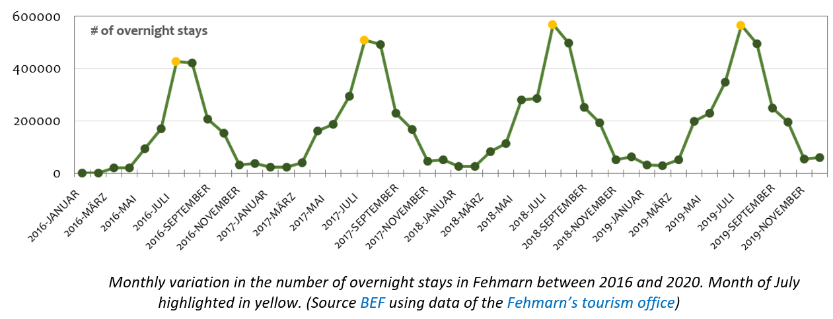
Context – Visitors
Yearly number of overnight stays grew 12% from 2.2 to 2.5 million (2017-2019).
Average overnight stay length decreased from 6.3 to 5.8 nights (2016-2019).

Slide 4
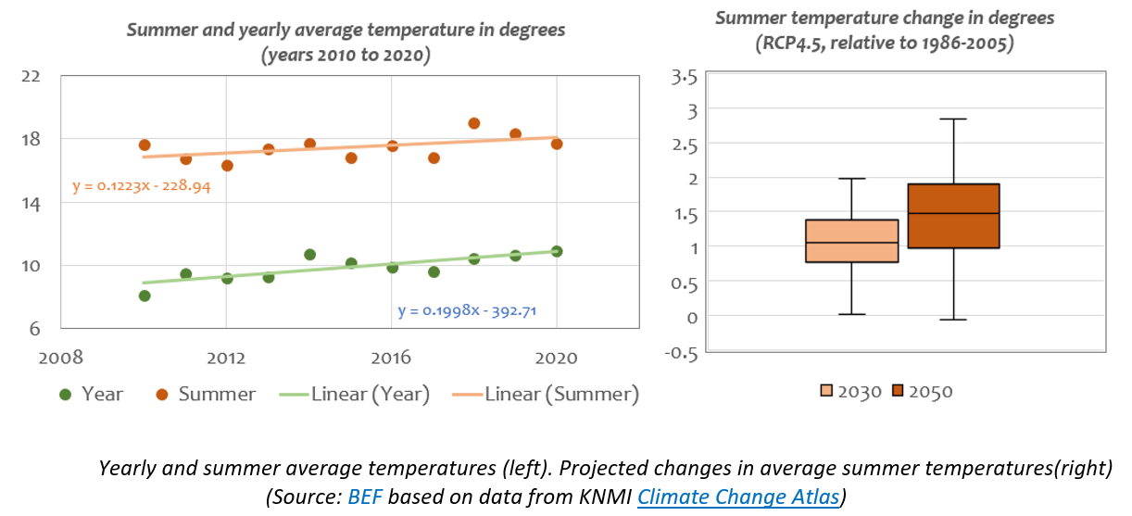
Context – Climate
2.8
2.0
1.5
1.1
Average annual/summer temperature increased 0.19 and 0.12 deg/yr respectively (2010-2020).
Median summer temperatures projected for RCP4.5 using 43 models (ref 86-05*).

Slide 5
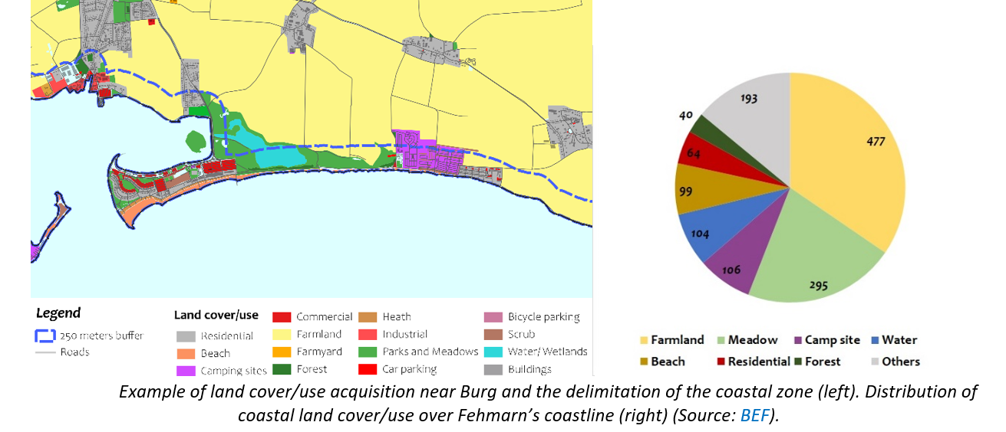
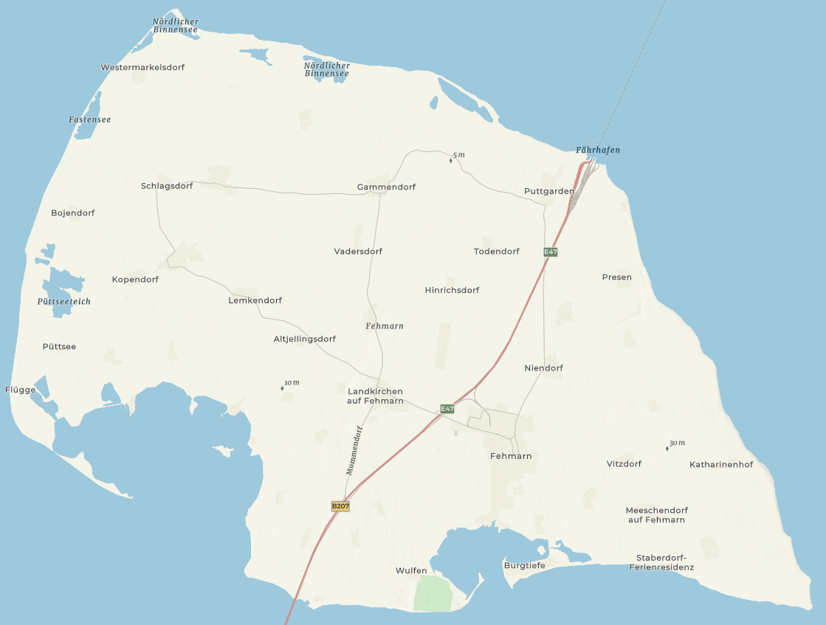
Context – Land cover & use
Majority of coastal land (< 250m shoreline) dedicated to agriculture activity (34.5%).
Campsites uses about 106ha of costal land approx. = to total beach area (99ha).

Slide 6
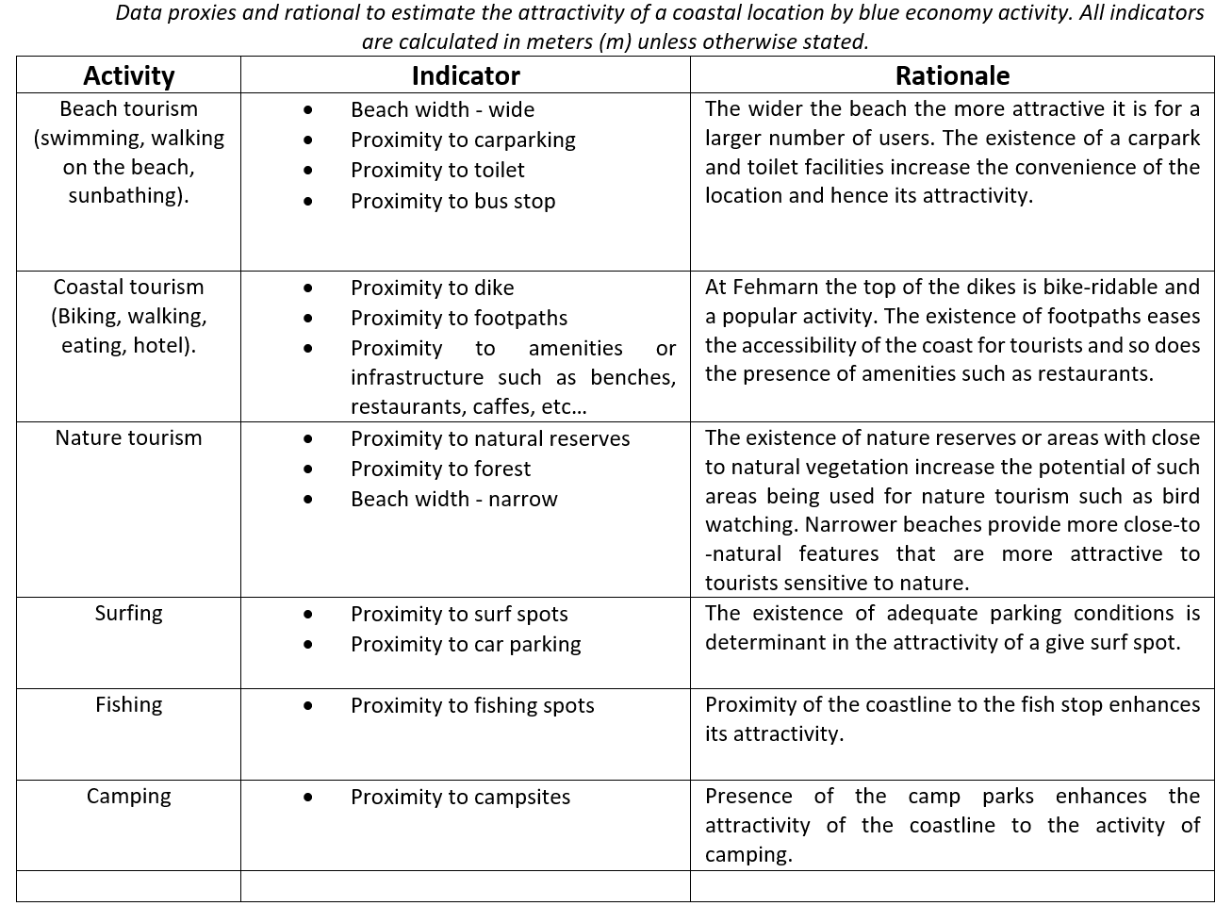
Mapping of blue economy activities
The distribution of blue economy is dependent on attractivity of a coastal location.
forest
d
land
d
d
WC
d
ocean
d
w
beach

Slide 7
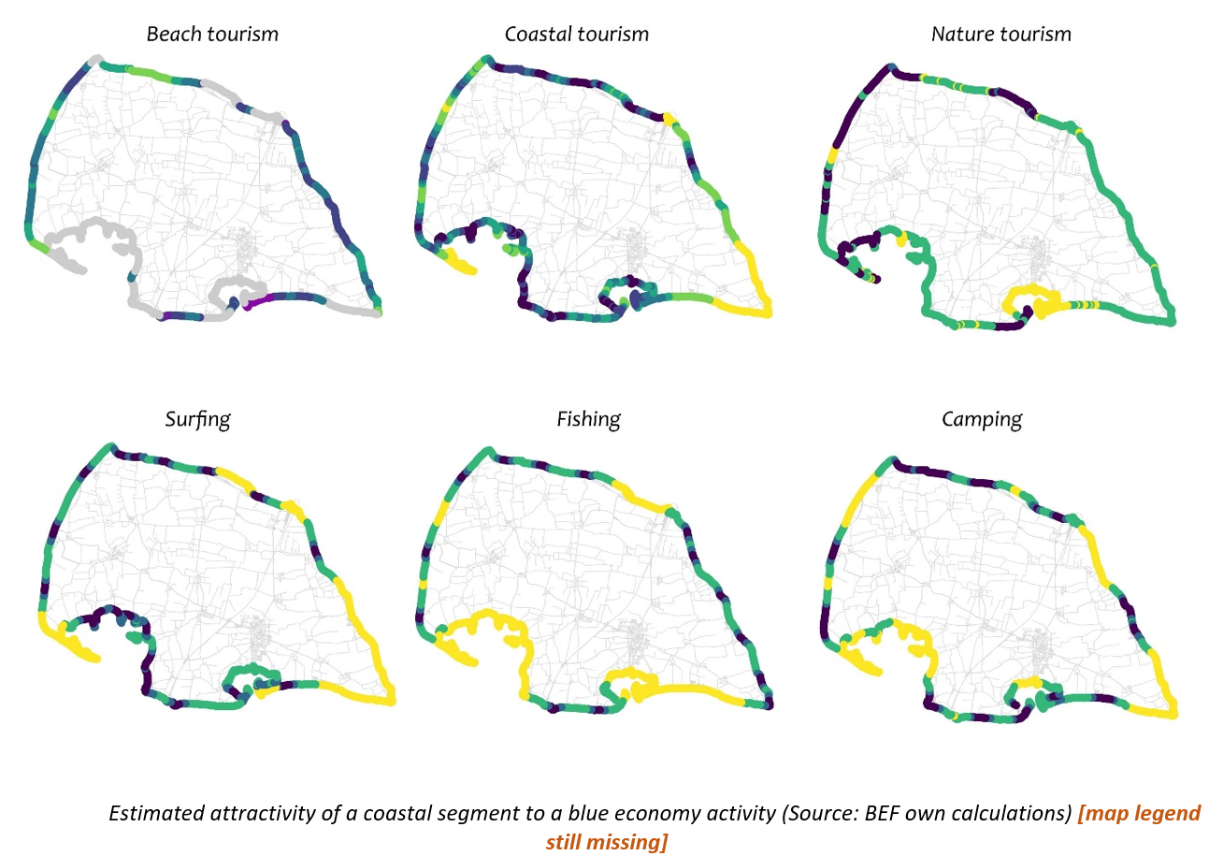
Mapping of blue economy activities

Slide 8
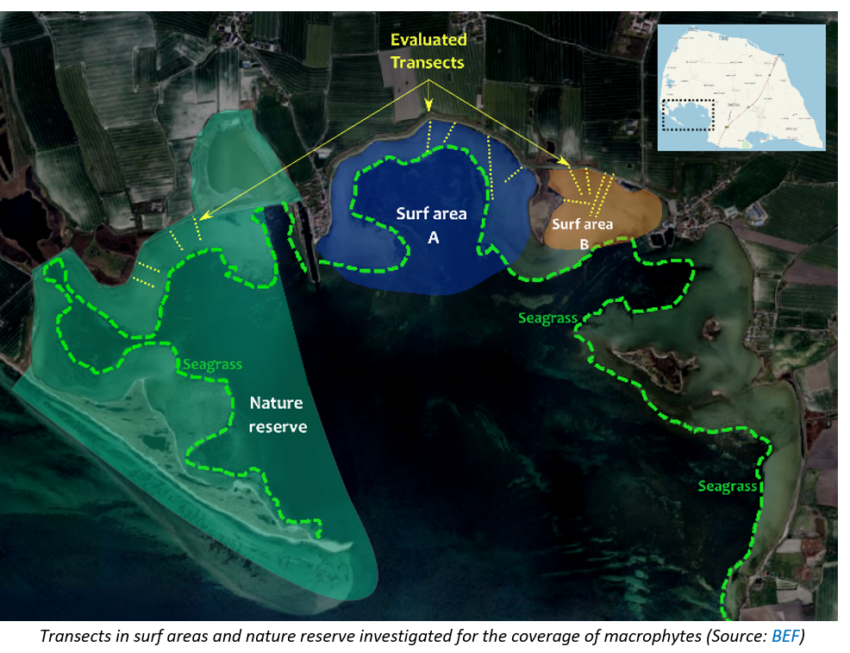
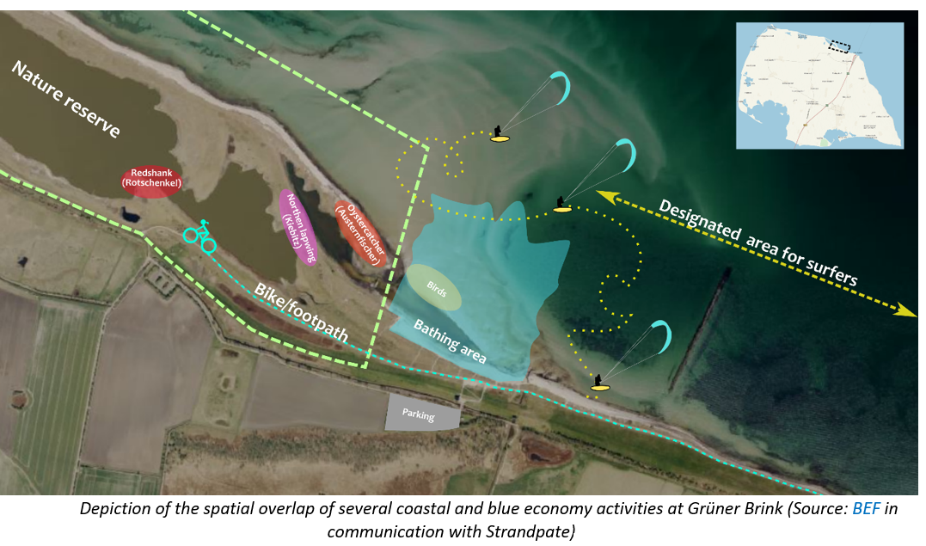
Mapping of coastal conflicts
In the context of Marine Spatial Planning (MSP) spatial conflicts exist when:
a) the direct competition over a limited space or
b) one coastal activity negatively impacts another

Slide 9
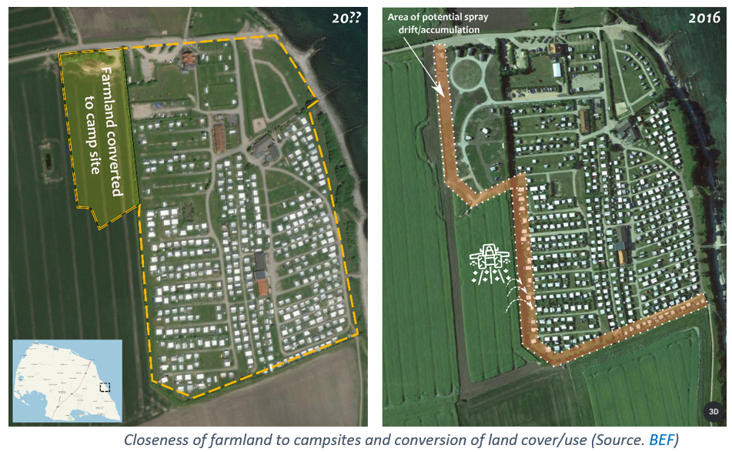
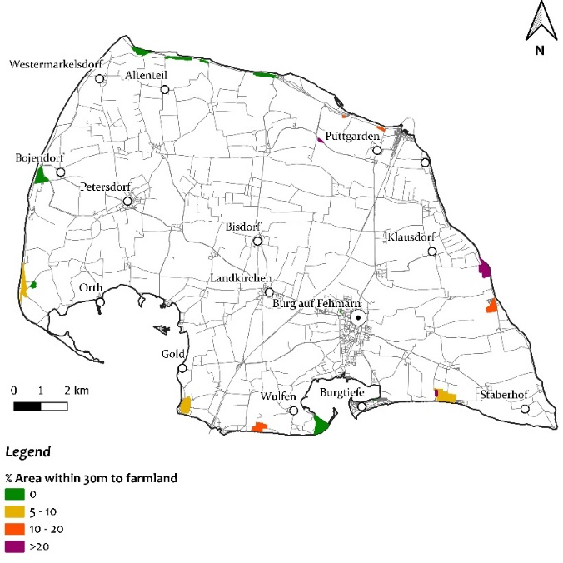
Mapping of coastal conflicts
Campsite area less than 30m to farmland

Slide 10
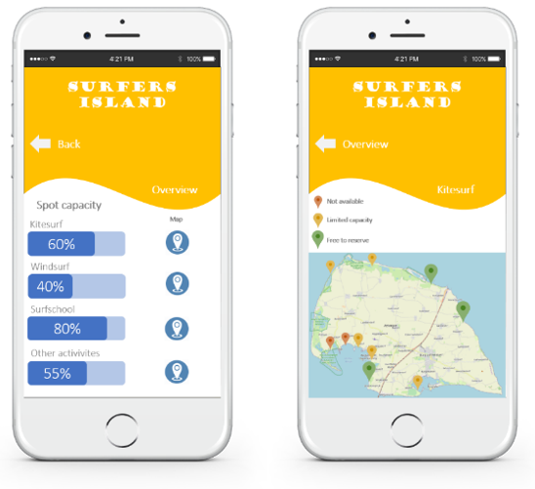
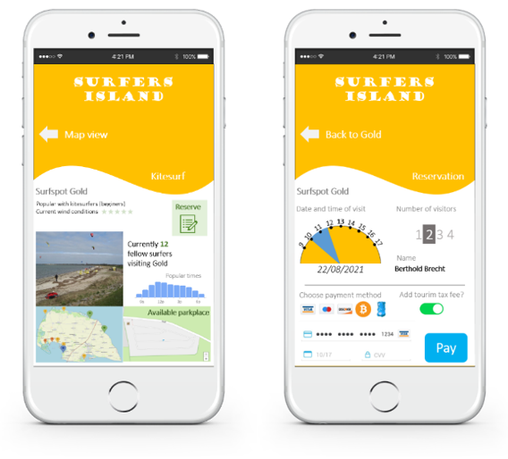
Conceptualization of the surfer's island App (SIA)
Core principle: incentivise the use of parking spaces at surf spots according to the spot's sustainable capacity.
Overview
Availability map
Detail map/parking
Payment

Slide 11
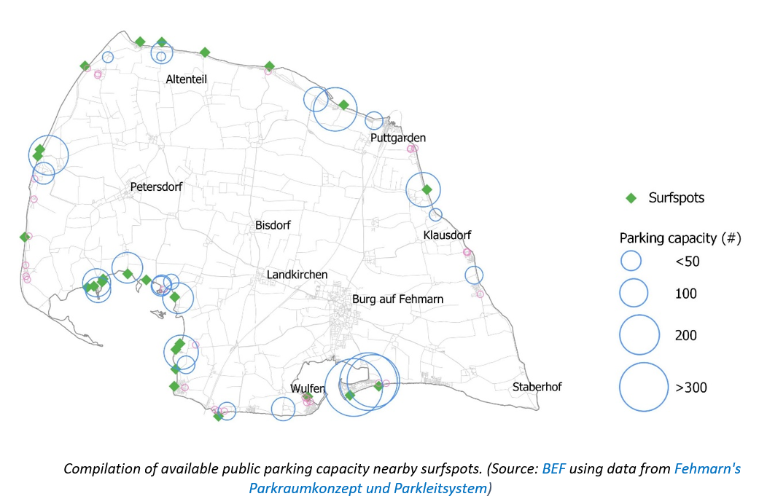
Parking capacity data for SIA

Slide 12
Parking capacity data for SIA
Hard to define the “sustainable capacity” of each surf spot. (function of current number of visitors, free parking places, ecological considerations).
SIA is thought with surfers in mind but probably would make more sense to have a general “parking App” (categorizing visitors as surfers and non-surfers).
SIA will require additional physical structures (e.g., QR code readers) to effectively control the flows.
Only one element of the management strategy (physical demarcation of the hotspots, guiding structure to channel surfers entering the water and avoid dispersion).

Slide 13
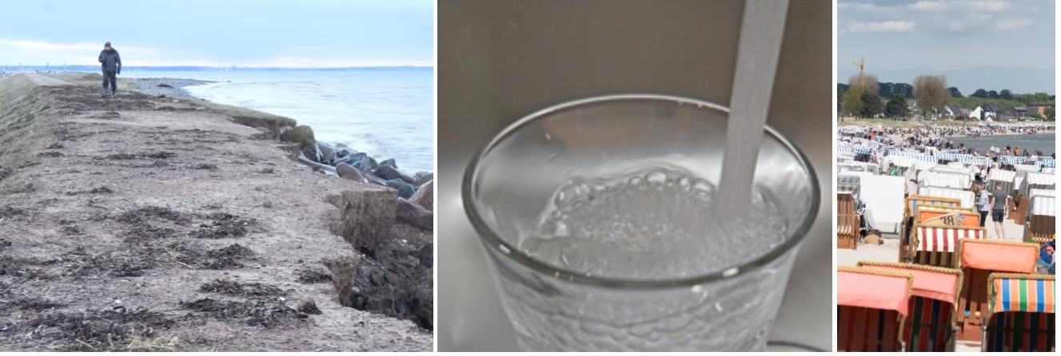
Climate change adaptation
Initiate the discussion for an adaptation plan for the island.
Quantify relevant climate change impacts (water supply, coastal flooding, heat).
Propose some adaptation options.

Slide 14
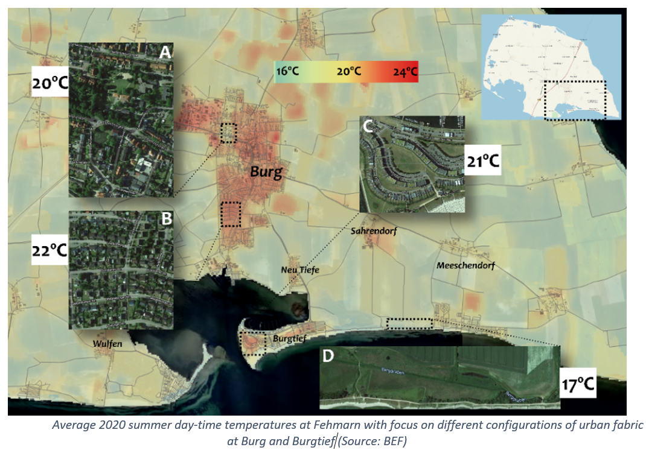
Climate change adaptation - Heat
Summer 2020 day-time temperature map (based on LandSat8 data)
Adaptation measures targeting urban heat
Reduce “sealed surface” area.

Slide 15
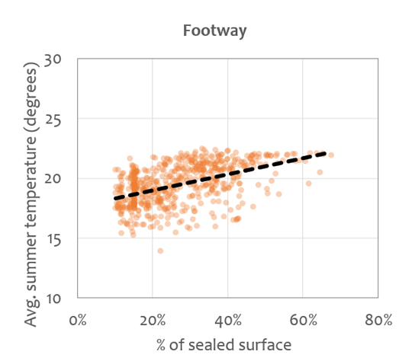
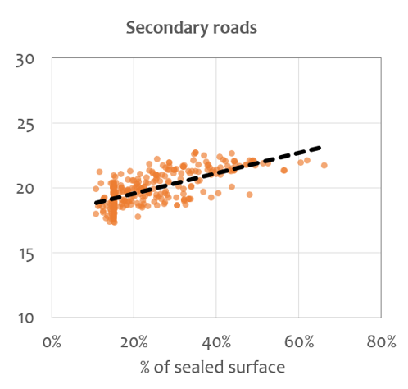
Climate change adaptation - Heat
Summer 2020 day-time temperature map (based on LandSat8 data)

Slide 16
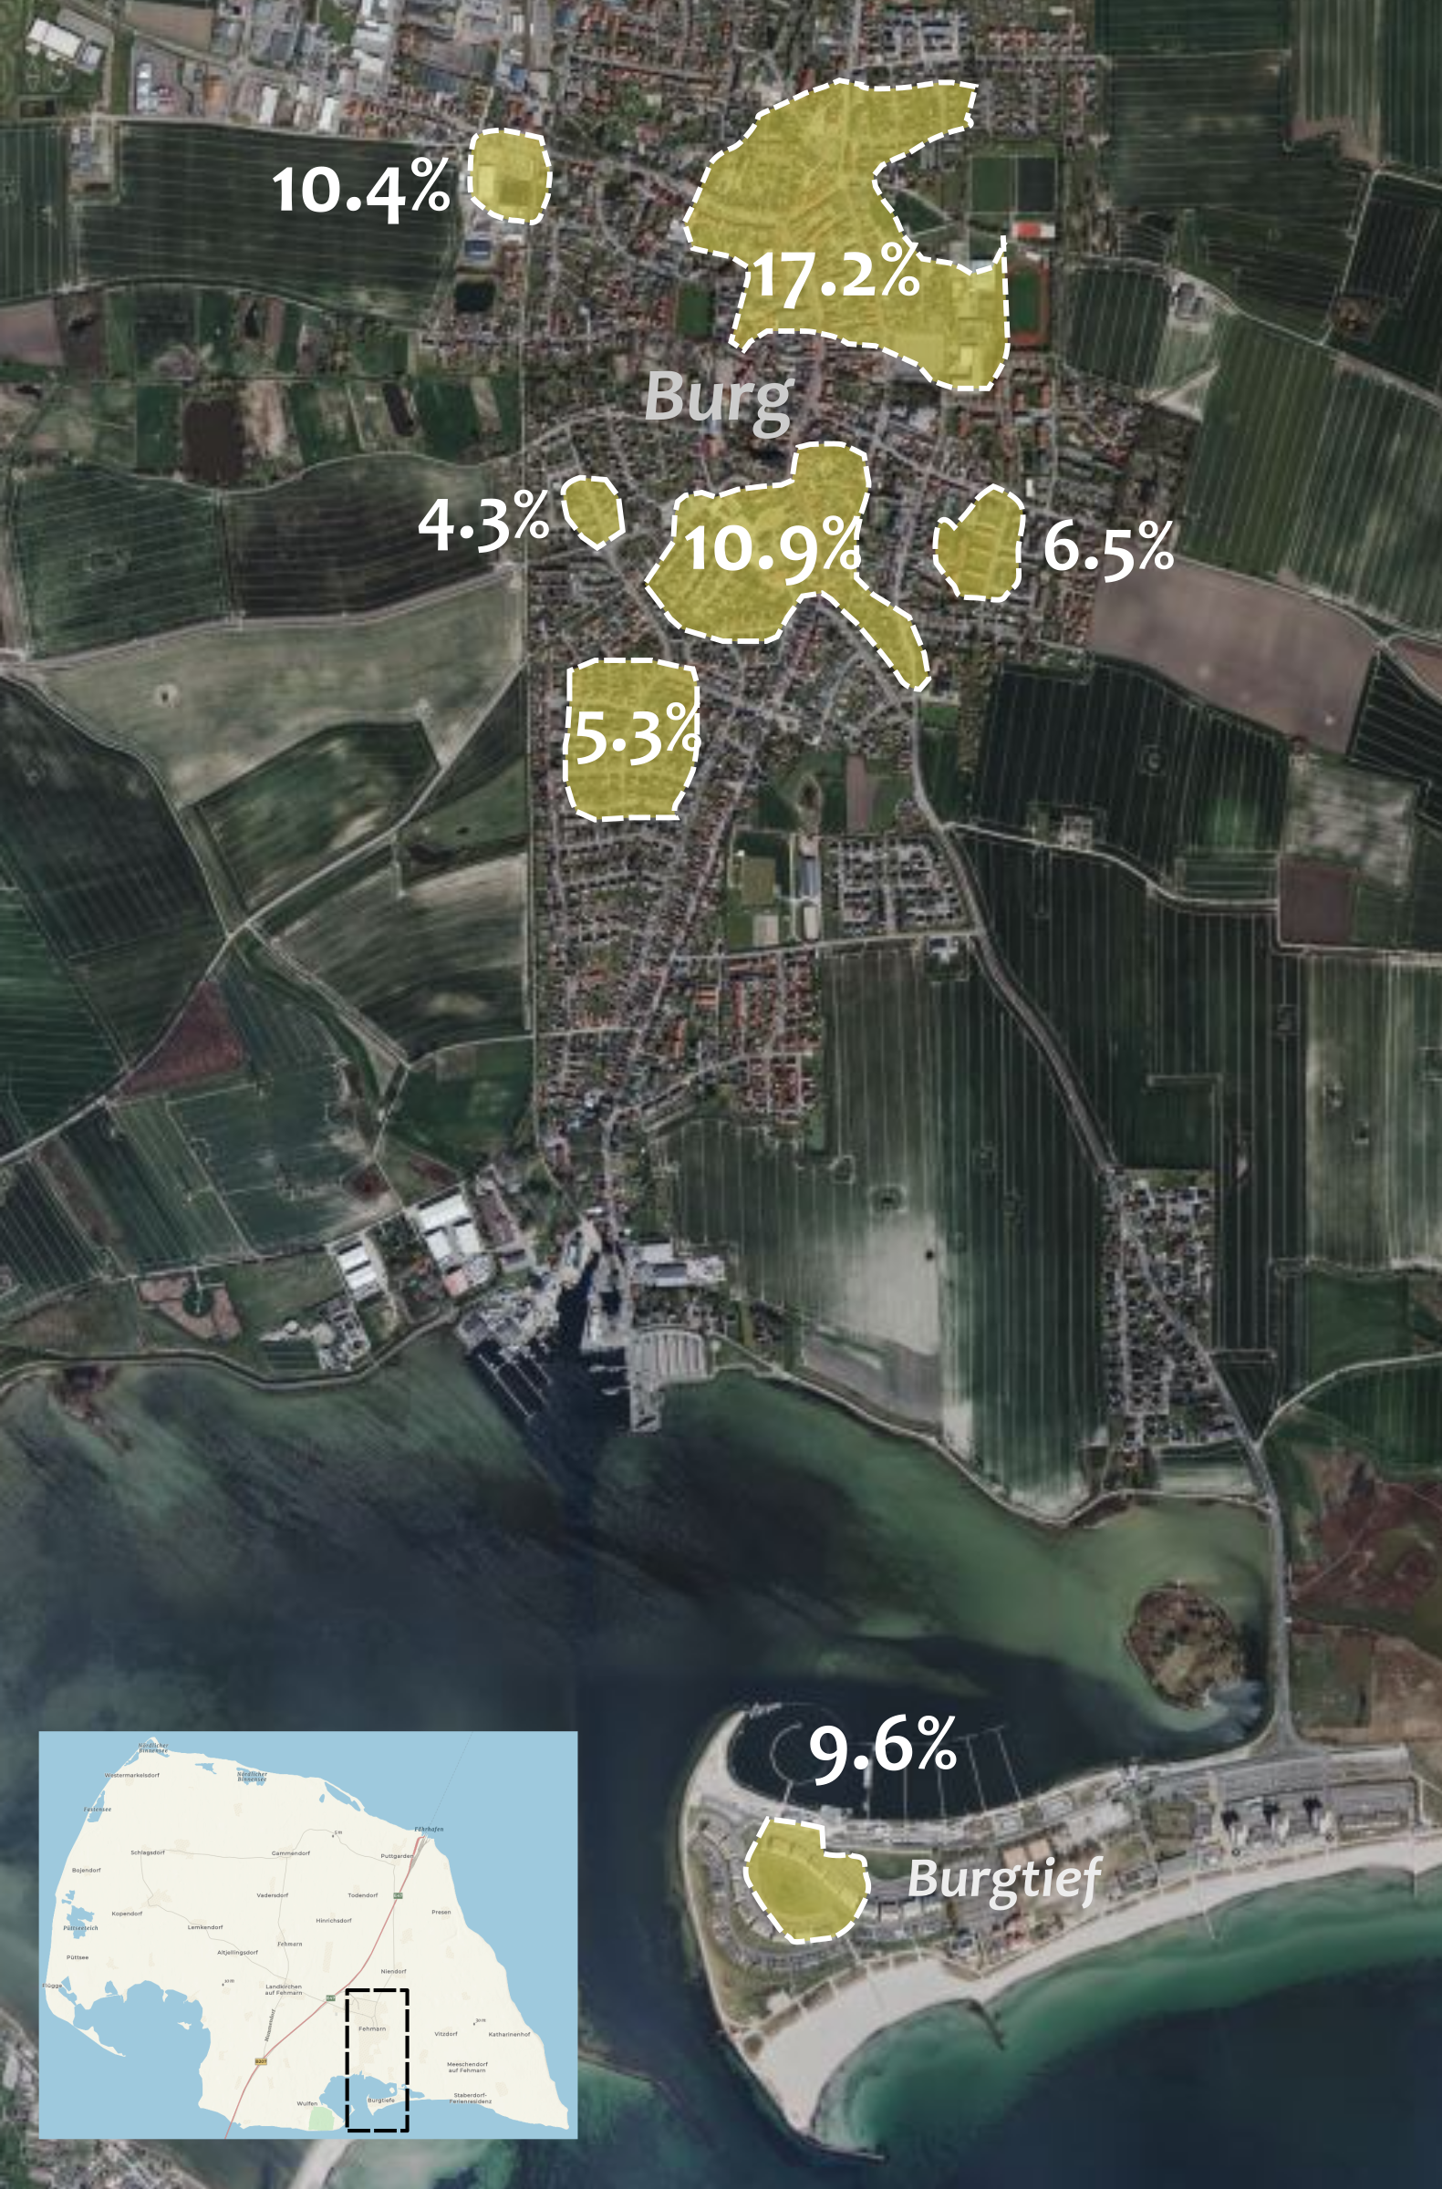
Climate change adaptation - Heat
Example:
Fehmarn decides to adapt locations with average summer temperatures above 21 degrees so that next summer these are lowered to 20 degrees.
Fehmarn then hires BEF to determine how much additional green space needs to be put in place?

Slide 17
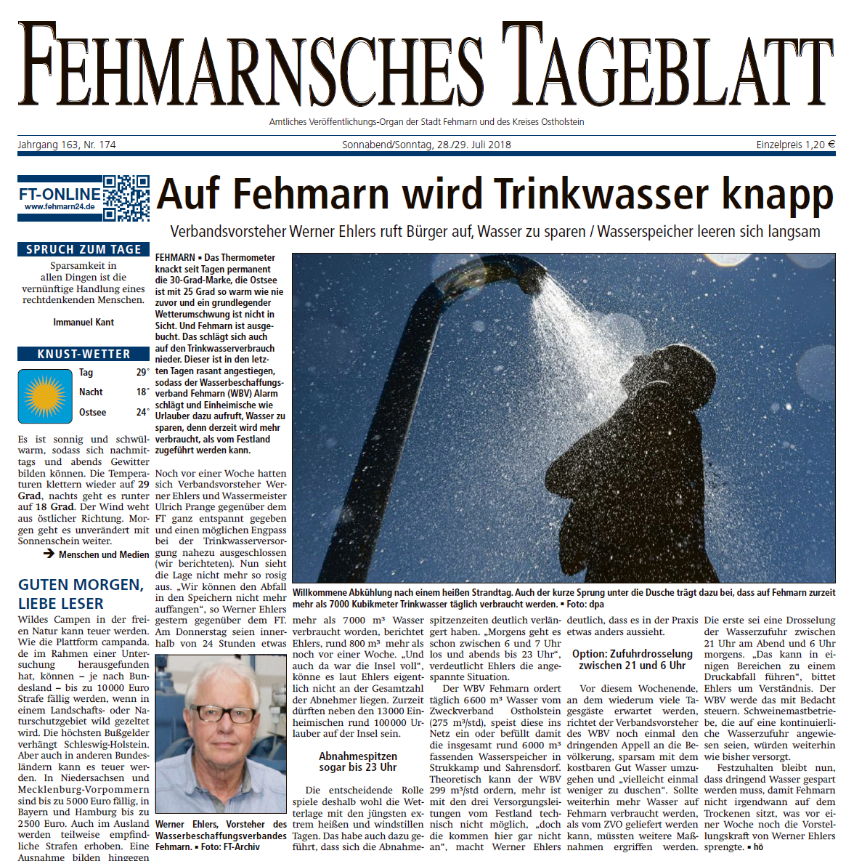
Climate change adaptation – Water supply
Fehmarn receives on average 1.4 million m3 of water annually (2016-2020).
Yearly supply increased moderately by 0.65%, supply in the summer months increased about 8.4%.
Warmer summers are likely to pose additional stress to Fehmarn’s water supply system.
But how much more stress?

Slide 18
Climate change adaptation – Water supply
Water supply and temperature positively and non-linearly correlated.
Simple model (only temperature and independent variable) captures 82% of yearly variability.
In summer months supply is underestimated by circa 9.2 (+10% recalibration).

Slide 19
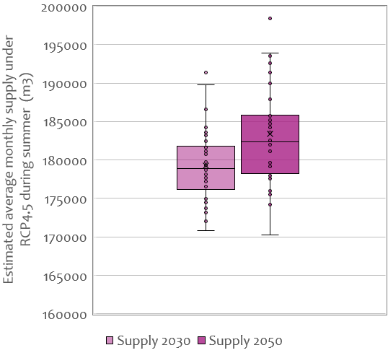
Climate change adaptation – Water supply
Most of the additional water supply estimated is required by 2030 (short-term adaptation).
Moderate climate change adds about 10% of water needs on top of those from an increase in tourists.
But… real management takes place at daily scale!
2016-2020 summer mean

Slide 20
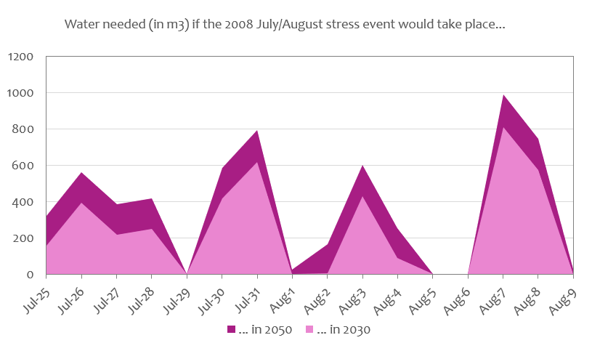
Climate change adaptation – Water supply
What if, the summer of 2018 would happen in 2030 or 2050, what additional daily water volumes would Fehmarn require?
25% of the population has 1 less shower and skips 1 day of laundry

Slide 21
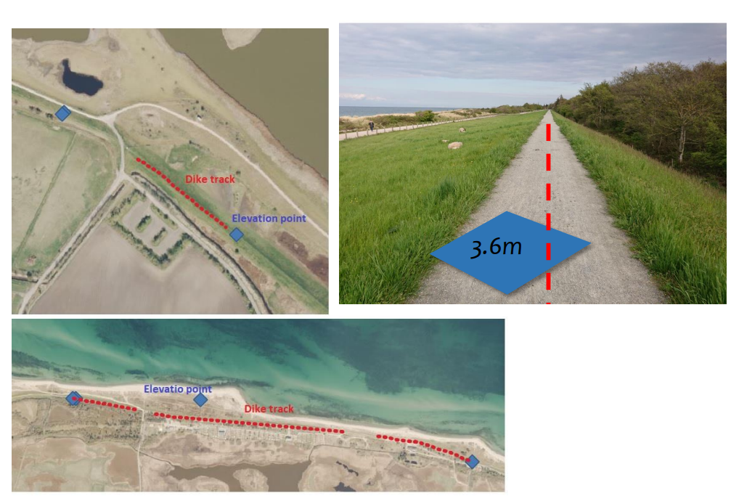
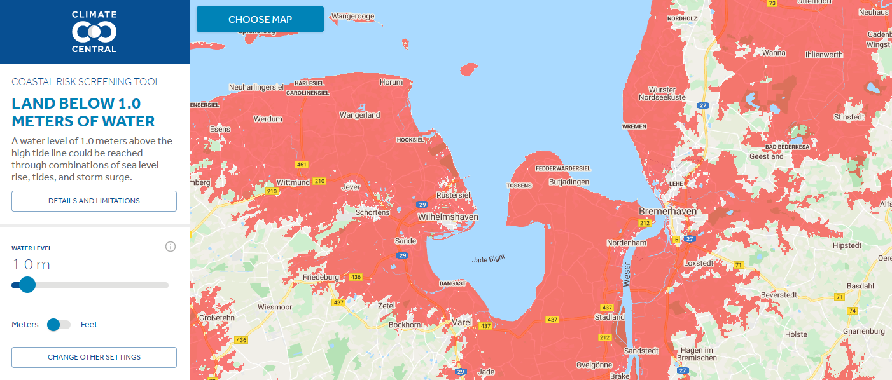
Climate change adaptation - Coastal flooding
Account for the effect of local dikes in flooding simulations from sea-level rise.
Dike-height sampling (May 2021)

Slide 22
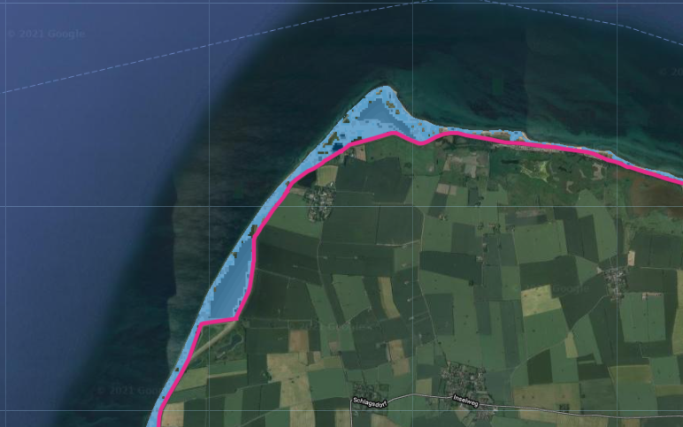
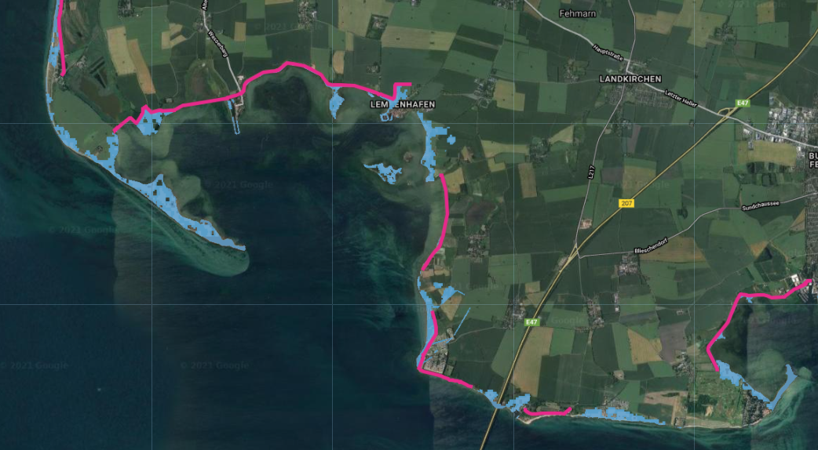
Climate change adaptation - Coastal flooding
Work in progress
Lemkenhafen
Altenteil
2.7m
2.7m

Slide 23
Climate change adaptation - Coastal flooding
Work in progress
2.7m
3.2m
Lemkenhafen

Slide 24
Summary of results
Blue economy activities along the coastline and (some) spatial conflicts mapped.
Surfers App visualized and parking-capacity database created. Operational challenges raised.
Three climate-related impacts quantified at relatively detailed spatial and temporal scale.
First quantitative investigation of potential adaptation options for the island of Fehmarn.
Effect of vegetation in lowering urban heat estimated (urban planning).
About 10% additional water needs in the summer under moderate climate change (even in the absence of tourism growth).
Flood extents for different surge heights estimated with a simple but locally-representative flood model.

Slide 25
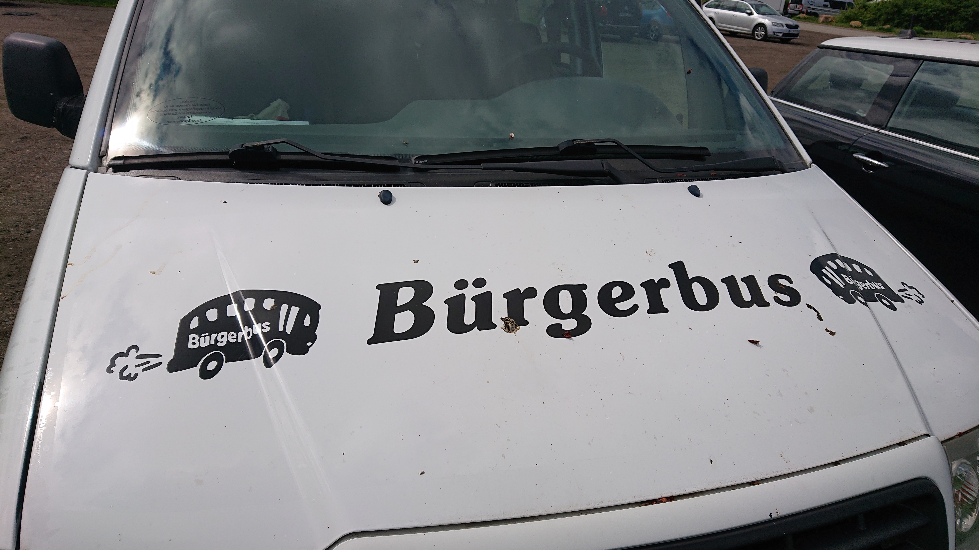
We thank:
The city of Fehmarn
Frau Beate Burow
Tolles Wetter
... and the Bürgerbus

Slide 26
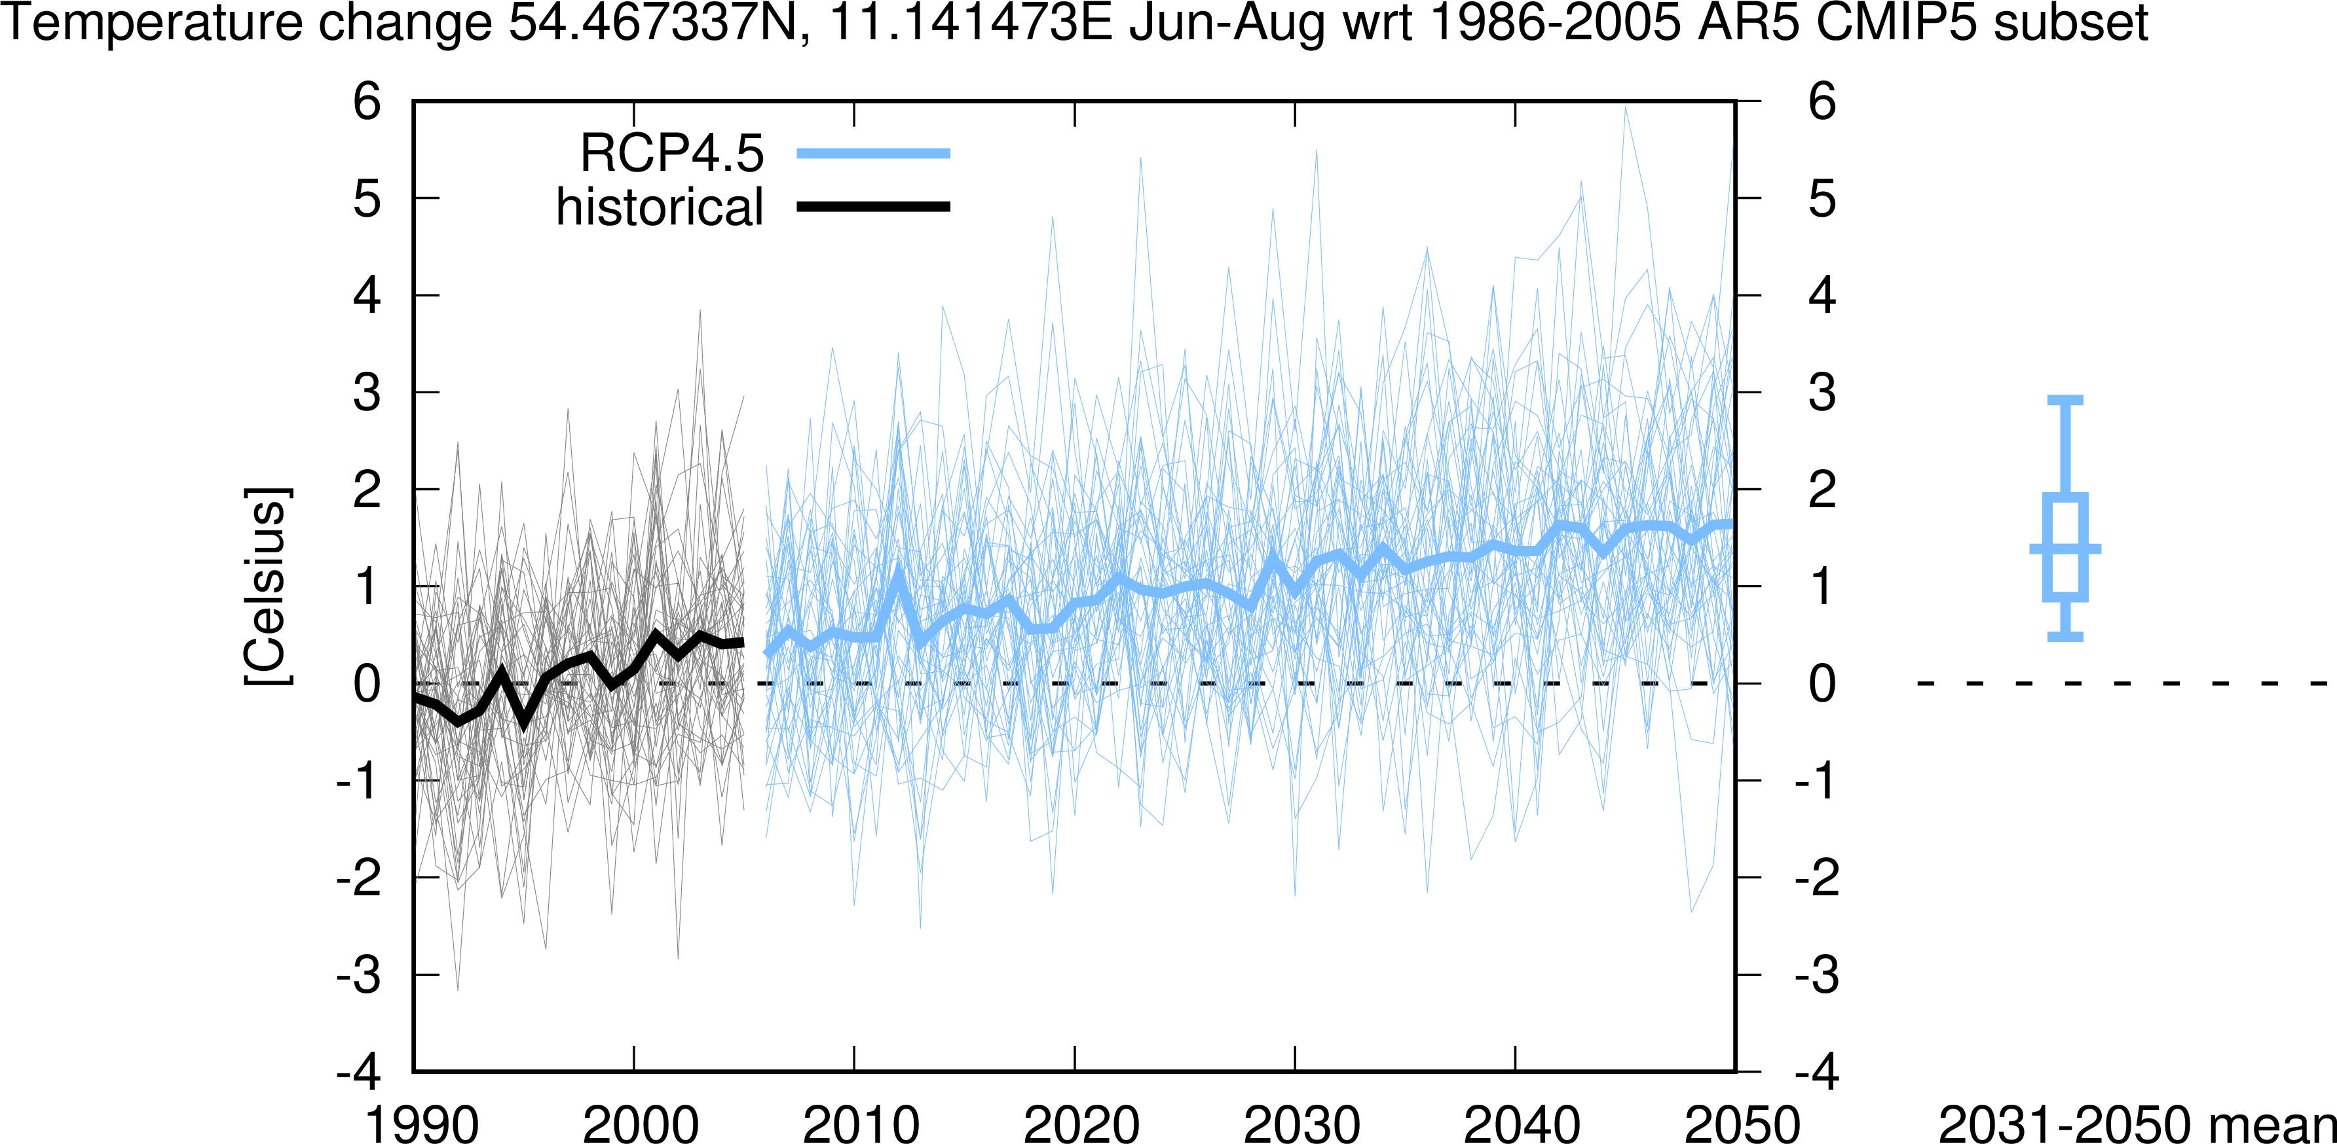
Climate model spread

Slide 27
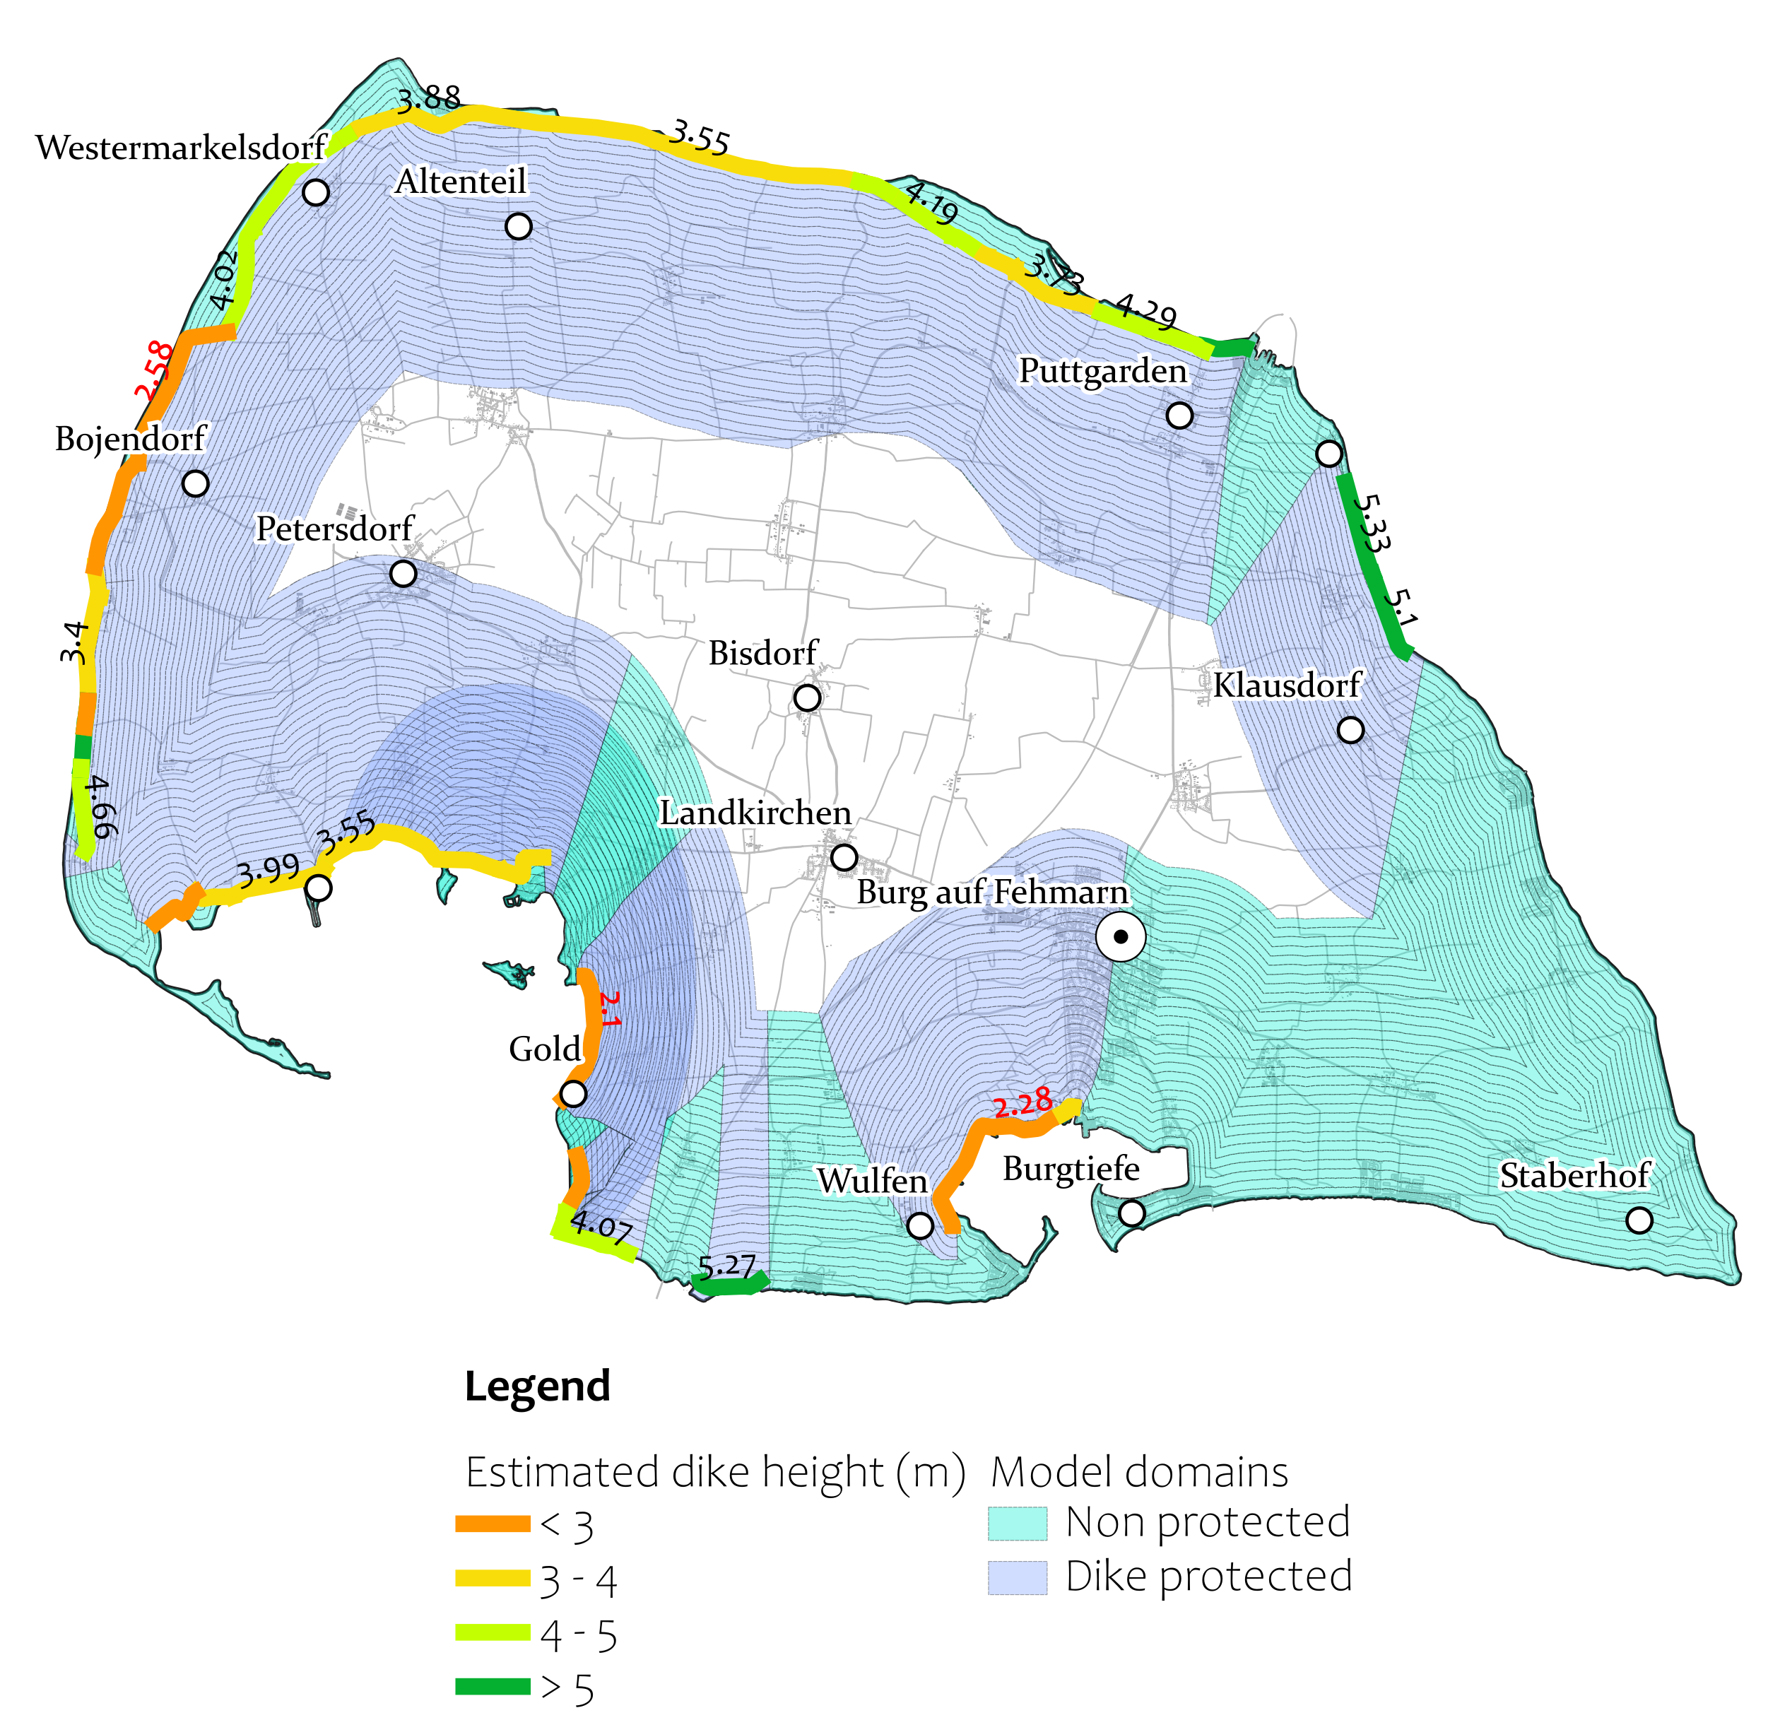
Flood modeling domain and dike height

Slide 28
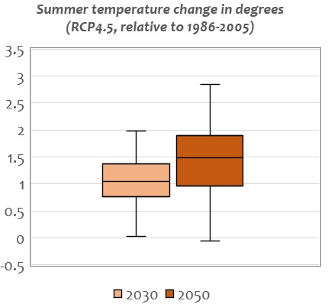
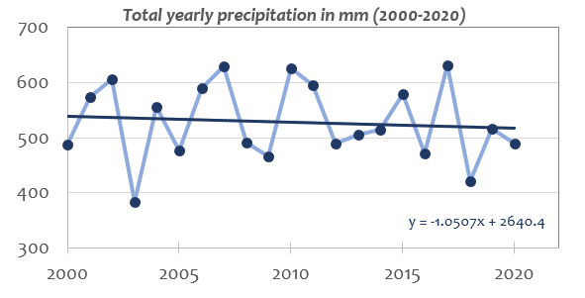
Precipitation trend & temperature projection

Slide 29
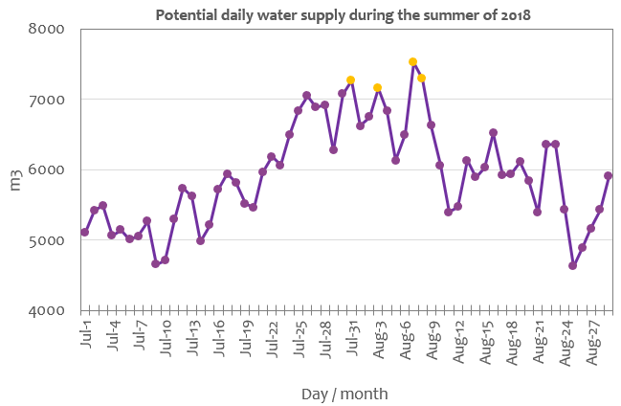
Daily water supply estimate

Slide 30
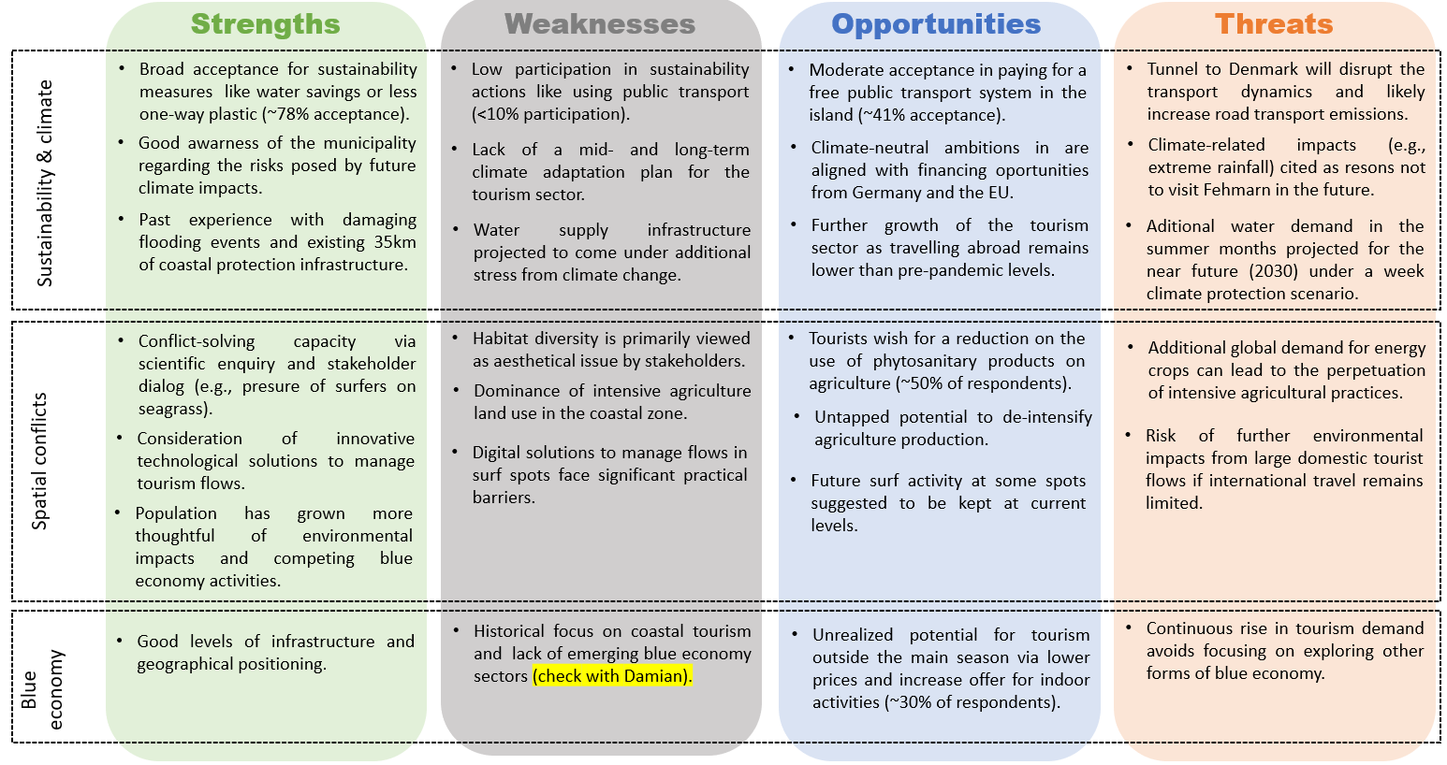
SWOT analysis

